Slide 1
A Look Into the Air Fryer Market
Demand, Costs & Competitive Positioning
Sai Gadipati, Nathan Luu, Nate Kim, Austin Song
Roles: Data Analyst · Data Scientist · Pricing Analyst

Slide 2
Market Overview
10
5
~$50–$230
Competing Brands
Years of Data
Price Range
Chefman to Ninja
2019 – 2023
Wide spread of prices
The U.S. air fryer market grew rapidly through the early 2020s, driven by the pandemic-era surge in home cooking and health-conscious consumer trends. By 2023, the market had consolidated around a handful of dominant brands consisting of Ninja, Instant Pot, and Oster. Other budget-tier players faced mounting share pressure. This analysis covers 10 brands and five years of panel data

Slide 3
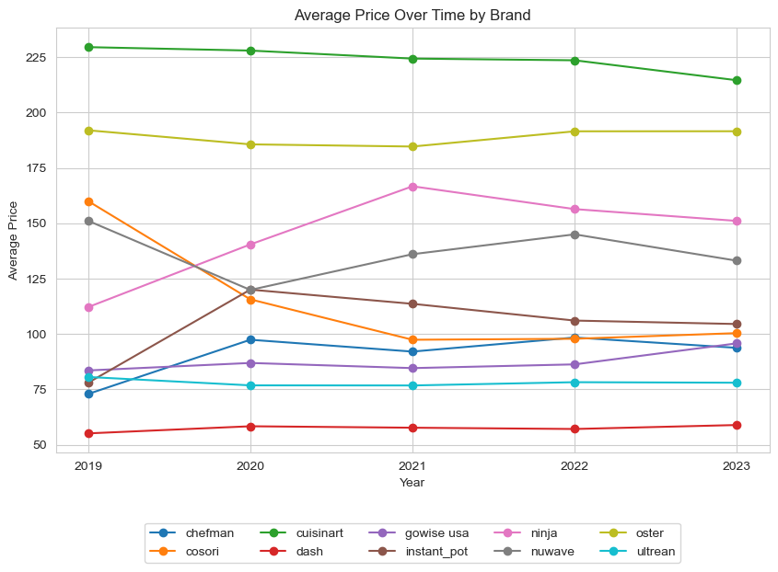
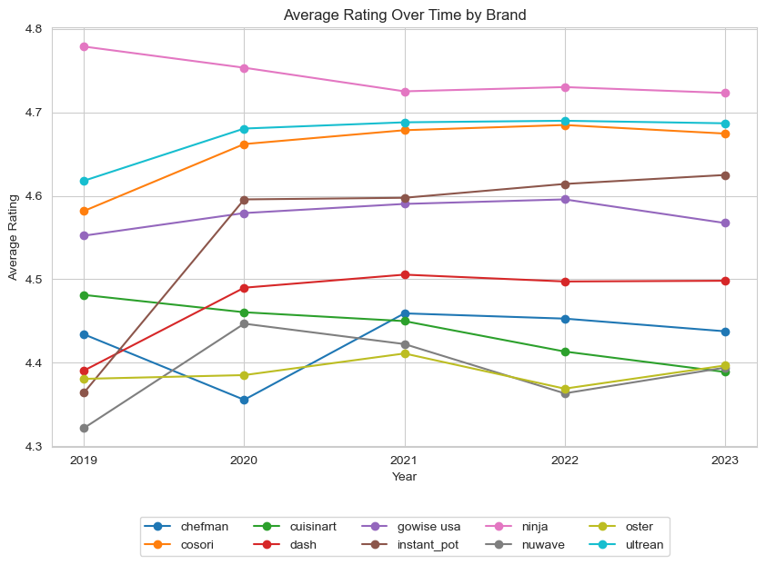
Market Trends: Price & Consumer Ratings
Prices are relatively stable over time within each brand indicating that this is a market defined by clear price tiers, not price competition. Any changes in prices come from brands seeking to enter a new tier of competition, such as Ninja in 2021.
Consumer ratings are uniformly high, ranging from 4.1 to 4.6 stars, and flat over time. This suggests that quality perceptions are already baked in.
Takeaway: Cuisinart and Oster consistently command the highest prices ($190–$230). Dash and Ultrean compete at the budget end (~$50-$75). Notably, higher prices do not translate into higher consumer rating.

Slide 4
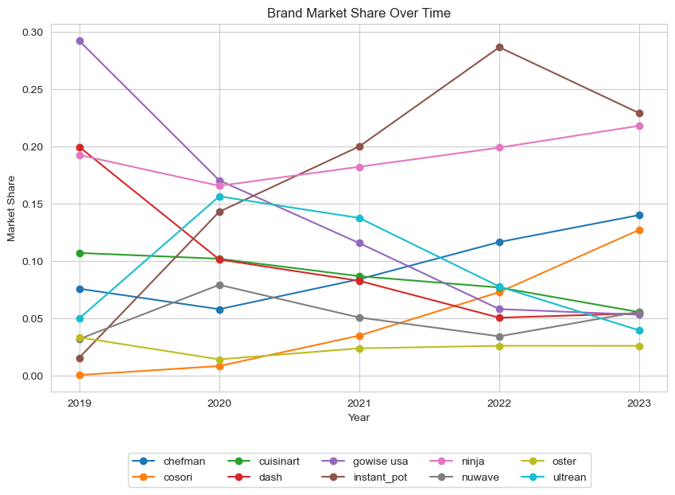
Market Share Dynamics
↑ Gaining Share
→ Stable
↓ Losing Share
Ninja, Instant Pot, Cosori
Cuisinart, NuWave, Oster
GoWise USA, Dash, Chefman, Ultrean

Slide 5
The Demand Model
Methodology
Model Equation
Model type: Logit-style demand model estimated by OLS on log market share Outcome: log(brand_share) — captures proportional changes in demand Controls: Average price, average rating, 5 product feature shares Fixed effects: Brand dummies (ref: Chefman) + Year dummies (ref: 2019) R²: 0.7635 — model explains 76% of variation in log share Key constraint: One single price coefficient shared by all brands & years
Price Coefficient: -0.0377 — means that every $1 increase in average price is associated with a 3.8% decrease in brand share when holding brand, year, rating, and features constant.
Negative sign crucial because higher prices should reduce market share
log(s_bt) =
α₀ (intercept)
+ αₜ (year fixed effect)
+ γ_b (brand fixed effect)
+ β_price · p_bt
+ β_rating · r_bt
+ Σ β_ℓ · x_btℓ (features)
+ ε_bt (error)

Slide 6
What Drives Demand?
▲ STRONGEST POSITIVE IMPACT
▼ STRONGEST NEGATIVE IMPACT
+12.88
Window
−9.51
Dual Basket
Consumers strongly value being able to see food cooking. This is the single largest positive driver of market share in the entire model.
Despite being marketed as a premium innovation, dual-basket designs actively hurt market share according to the analysis.
+9.82
Compact
−5.67
Rotisserie
The industry standard form factor. Nearly 98% of products carry this feature, making it a baseline expectation rather than a differentiator. However, brands without it face a steep share penalty.
Rotisserie attachments are similarly niche and negatively associated with share. Specialized add-ons appear to reduce broad consumer appeal rather than expanding the customer base.

Slide 7
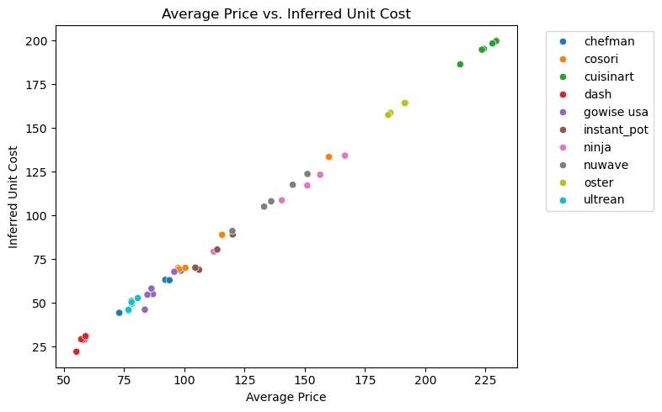
Inferred Unit Costs & Markups
Brand | Avg Price | Unit Cost | Markup
Ninja | $110.80 | $79.86 | $30.93
Instant Pot | $85.48 | $54.75 | $30.72
Oster | $90.00 | $59.81 | $30.19
Cuisinart | $119.65 | $90.62 | $29.02
GoWise USA | $59.72 | $30.45 | $29.27
Cosori | $68.99 | $39.74 | $29.25
NuWave | $74.94 | $45.82 | $29.11
Ultrean | $48.39 | $18.91 | $29.48
Dash | $44.72 | $15.87 | $28.86
Chefman | $54.96 | $26.78 | $28.18
Key takeaway: Markup costs are more or less uniform across all brands, indicating that the key differentiator between the brands is unit cost.

Slide 8
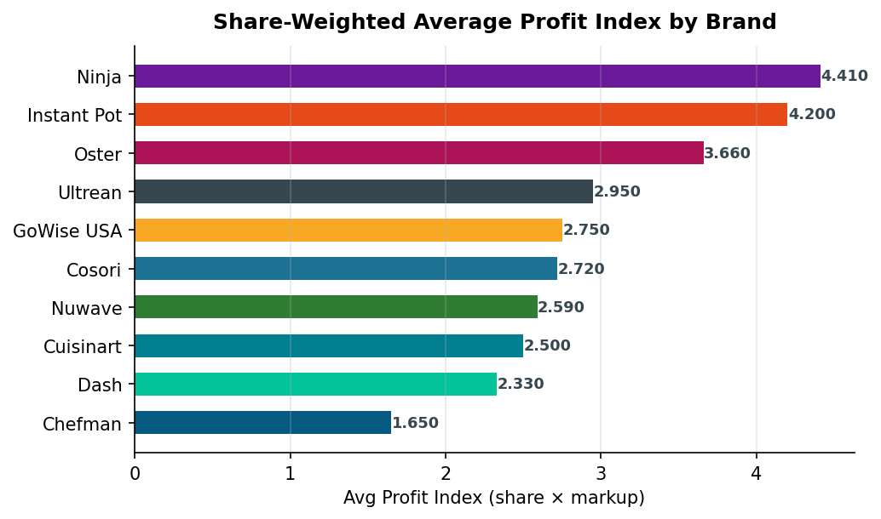
Share-Weighted Profitability
What is the profit index?
The profit index = brand_share × markup. It is a share-weighted proxy for profitability, not the total dollar profit. It captures which brands combine high pricing with market presence.
Ninja
Highest share + strong markup = top profit index
Instant Pot
Fast-growing share amplifies solid markup
Oster
Large stable share sustains profitability

Slide 9
Conclusions
Brand matters far more than price
Window and compact features drive share
1
Brand fixed effects explain most of market share variation. Competing on price alone is not a viable strategy in this market.
4
Brands seeking to gain market share should prioritize viewing windows and compact form factors. Rotisserie and dual-basket features are liabilities, not differentiators.
Ninja and Instant Pot are pulling away
Dash and NuWave face pressure
2
Both brands combine growing market share with high markups and strong profit indices. They are the clearest market leaders heading into 2024.
5
Declining market share trajectories combined with smaller markups make these brands the most vulnerable in the competitive landscape.
Premium pricing does mean consumer satisfaction
3
Cuisinart and Ninja have the highest prices, but ratings are flat across all brands. Willingness to pay is driven by brand strength, not necessarily quality.

